Slide 1
FLEGT VPA Independent Market Monitoring (IMM)

Slide 2
IMM Background
IMM is a condition of some FLEGT VPAs (e.g. Indonesia)
Builds on IMM proposal by EFECA in EFI-commissioned report issued 2012
Funded by European Commission through DEVCO
Budget: €4.4 million over 5 years (2014-2018)
Hosted by International Tropical Timber Organisation (ITTO)
Promotes expansion & diversification of trade in tropical timber from sustainably managed and legally harvested forests
Membership = most producer & consumer countries.
Record of statistical capacity building, data collection & market information

Slide 3
IMM Objectives
Generate information that demonstrates changes in trade of legally verified timber and timber products in the EU market
Improve knowledge and understanding of the impacts of VPAs on timber prices, trade and market trends globally
Ensure VPA countries & EU provide reliable stats and info on FLEGT timber trade and acceptance in their reporting
Inform decisions by VPA Joint Implementation Committees (JICs) by providing timely & accurate info on market impact
Contribute to monitoring the impacts of the FLEGT Action Plan and to inform its implementation
Develop a long-term strategy for sustaining the IMM in consultation with the EU and VPA partner countries

Slide 4
IMM Oversight & Guidance
Project Steering Committee (PSC)
Monitors IMM progress, review work plan and reports
ITTO & EC representatives
Observers e.g. EFI, Eurostat, interested government agencies
Advisory Committee
Advises on technical aspects, promotes coordination, facilitates participation by stakeholders and communication of IMM activities.
ITTO, FAO, UN-ECE, Eurostat, EFI, government agencies from EU & VPA Partner countries, trade associations, other organisations interested in timber market monitoring.
Timber Market Monitoring Committee (TMMC)
Facilitates info exchange, avoids duplication, improves market monitoring practices & stats, common data protocols
AC sub-group of organisations directly engaged in market monitoring
ITTO, EFI, Eurostat, Indufor, ATIBT/IFIA, STTC, FAO, UNECE, Global Timber Forum, Chatham House, WRI, & Forest Trends.

Slide 5
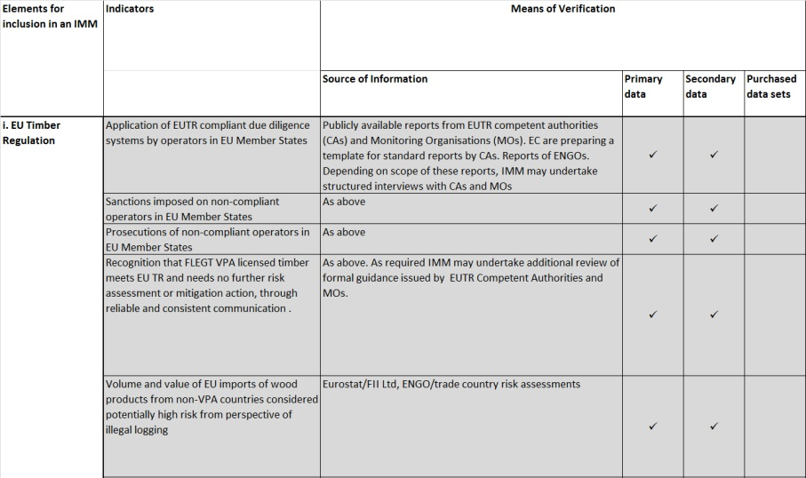
IMM Methodology
Framework (currently in draft) of 52 indicators for quantitative assessment of market impacts

Slide 6
33 EU-wide indicators
Overall EU market for all FLEGT VPA timber
Examples:
market impact of EUTR implementation;
scope and content of public sector procurement policies;
timber procurement requirements established by EUTR MOs, TTF’s & major retailers
handling of VPA licenses in FSC and PEFC CoC standards
perceptions of VPA licensed timber in design and architectural community
recognition of FLEGT VPAs in guidelines for assessment of forest sector risk in the financial sector

Slide 7
19 VPA partner-specific indicators
Changing market for each VPA partner country
Examples:
monitoring of volume and value of trade flows between the VPA partner country, the EU and other markets;
prices for specific indicator products from the partner country;
time to clear customs
size and quality of investment in the VPA partner country
changing perceptions of timber from the partner country resulting from VPA licensing.

Slide 8
Key operational issues
Phased approach - progressively widen monitoring against indicators as more licensed timber becomes available & with rising awareness
Close working relationship with JMRM in Ghana and JICs in other VPA countries
Network of IMM correspondents in VPA Partner Countries & priority EU Member States reporting regularly
Additional surveys undertaken directly by IMM or by other members of TMMC
Linkage to trade associations (e.g. ETTF, GTF) to encourage input from private sector

Slide 9
IMM Outputs
Baseline report (Before end 2014)
VPA Partner timber production 2004-2013
VPA Partner-EU trade flows 2004-2013
Annual reports (First before end 2015)
Current status of licensing in VPA Partner countries
Annual update of production and trade data
Overview major trade trends & issues arising
Systematic review against indicators
Website
Quarterly e-news
Production and trade database
Data visualisation

Slide 10
Thank you imm@itto.int

